Slide 1

DIGITAL ASSIGNMENT 1 · PROGRAMMING FOR DATA SCIENCE
Employee Attrition Prediction
Using Machine Learning
An Exploratory Data Analysis and Data Preparation Study on a Multi-Plant Industrial HR Dataset
Vansh Goyal
Ritabrata Dey
Chetan Pareek
24BDS1156
24BDS1129
24BDS1125
School of Computer Science and Engineering (SCOPE) · Vellore Institute of Technology, Chennai
Notes:
Employee Attrition Prediction Using Machine Learning. This is Digital Assignment 1 (DA1) for the Programming for Data Science course at VIT Chennai, School of Computer Science and Engineering (SCOPE). Prepared by Vansh Goyal (24BDS1156), Ritabrata Dey (24BDS1129), and Chetan Pareek (24BDS1125). This phase of the project covers dataset identification and justification, dataset understanding, data preprocessing, and exploratory data analysis using R.

Slide 2
AGENDA
Table of Contents
01 Introduction
08 Dataset Understanding
15 Scaling
02 Problem Statement
09 Preprocessing Workflow
16 Exploratory Data Analysis
03 Objectives
10 Missing Values
17 Key Visualizations
04 Dataset Overview
11 Duplicate Analysis
18 Major Findings
05 Dataset Justification
12 Feature Engineering
19 Conclusion
06 Literature Review
13 Outlier Detection
20 Future Scope
07 Research Gap
14 Encoding
21 References
DA1 · EMPLOYEE ATTRITION PREDICTION
02 / 25
Notes:
Agenda for this presentation, following the structure of the DA1 report: Introduction, Problem Statement, and Objectives set up the motivation. Dataset Overview, Justification, Literature Review, and Research Gap establish why this dataset and approach were chosen. Dataset Understanding through Scaling cover the full preprocessing pipeline performed in R. Exploratory Data Analysis, Key Visualizations, and Major Findings present the results. We close with Conclusion, Future Scope, and References.

Slide 3

SECTION 01
Introduction
1
Employee attrition is one of the most closely monitored HR metrics in large manufacturing organizations.
2
Multi-plant organizations face attrition patterns that vary by department, shift, role, and location.
3
Manual identification of at-risk employees becomes impractical as workforce size grows.
16.56%
4
Machine learning enables a shift from reactive HR intervention to proactive workforce planning.
of employees in the studied dataset left the organization
5
This report covers Phase 1: dataset preparation and exploratory analysis.
a scale that makes manual, case-by-case retention review impractical
DA1 · EMPLOYEE ATTRITION PREDICTION
03 / 25
Notes:
Employee attrition is one of the most closely monitored metrics in modern HR management, particularly in large manufacturing and industrial organizations where workforce stability directly affects production continuity, training investment, and operational cost. Unlike small enterprises, multi-plant organizations face added complexity because attrition patterns vary across departments, shifts, job roles, and locations, making manual identification of at-risk employees increasingly impractical as workforce size grows. With the increasing availability of structured HR data covering compensation, satisfaction, engagement, and safety records, machine learning offers a scalable way to move from reactive HR intervention to proactive workforce planning. This project follows a structured data science workflow: understanding the dataset, cleaning and preparing it, and conducting exploratory analysis to surface statistically observable patterns. This report corresponds to the first phase of that workflow: data preparation and exploratory analysis. The 16.56% attrition rate shown here is the actual class distribution in our 50,000-record dataset (8,282 of 50,000 employees).

Slide 4

SECTION 02
Problem Statement
"Attrition is typically discovered only after an employee resigns — by which point the opportunity for intervention has already passed."
1
2
3
Large Data, No System
Reactive, Not Proactive
A Foundational Gap
Multi-plant organizations generate large volumes of HR data but lack systematic tools to convert it into retention insight.
Organizations rely on exit interviews after the fact, rather than evidence-based, data-driven retention strategy.
A structured method to identify attrition-linked factors from historical records is still missing for industrial HR teams.
DA1 · EMPLOYEE ATTRITION PREDICTION
04 / 25
Notes:
Organizations operating across multiple plants and departments generate large volumes of employee data but often lack systematic tools to translate this data into actionable retention insights. Attrition is typically discovered only after an employee resigns, by which point the opportunity for intervention has already passed. There is a need for a structured, data-driven method to identify the factors most strongly associated with employee attrition using historical HR records, so organizations can move from reactive exit interviews to proactive, evidence-based retention strategies. This phase of the project addresses the foundational step: acquiring, understanding, cleaning, and exploring a suitable employee dataset to establish a reliable basis for later predictive modelling.

Slide 5






SECTION 03
Objectives
Identify & Justify Dataset
Understand the Structure
Preprocess the Data
Select an anonymized, multi-plant HR dataset suitable for studying attrition.
Analyze features, data types, and scale of the 50,000-record dataset.
Handle missing values, duplicates, encoding, and feature transformation.
Visualize in R
Summarize Insights
Build the Foundation
Generate informative visualizations of employee characteristics and patterns.
Distill EDA findings into preliminary attrition-linked attributes.
Establish a clean, well-understood dataset for the next analysis phase.
DA1 · EMPLOYEE ATTRITION PREDICTION
05 / 25
Notes:
Six objectives guide this phase of the project: (1) identify and justify the use of an anonymized, multi-plant HR dataset suitable for studying employee attrition; (2) perform a detailed understanding of the dataset structure, including features, data types, and scale; (3) preprocess the dataset by handling missing values, duplicate records, outliers, categorical encoding, and feature transformation; (4) generate informative visualizations in R to understand employee characteristics and attrition patterns; (5) summarize insights from exploratory data analysis and identify preliminary attributes associated with attrition; (6) establish a clean, well-understood dataset as the foundation for the next phase of analysis (predictive modelling).

Slide 6
SECTION 04
Dataset Overview
50,000
21
6
16.56%
Employee Records
Features
Manufacturing Plants
Attrition Rate
Target Variable
AttritionFlag (Yes / No)
Data Granularity
One row per employee
Scope
Multiple manufacturing plants, departments, and shifts
File Format
Excel (.xlsx) · Anonymized prior to analysis
DA1 · EMPLOYEE ATTRITION PREDICTION
06 / 25
Notes:
The dataset is an anonymized Human Resource dataset collected from multiple manufacturing plants of a large industrial organization, obtained during an industry internship and anonymized for academic use. It contains 50,000 employee-level records across 21 features spanning demographic attributes, compensation details, job-related conditions, engagement metrics, and attrition outcomes. The target variable is AttritionFlag (Yes/No), with one row per employee. The dataset spans multiple manufacturing plants (plant identifiers anonymized as Plant_A through Plant_F), departments, and shifts. Class distribution: No (retained) = 41,718 employees (83.44%), Yes (left) = 8,282 employees (16.56%).

Slide 7
SECTION 05
Dataset Justification
TYPICAL BENCHMARK DATASET
THIS DATASET
~1,470
50,000
employee records
employee records
Single organizational site
Multiple plants, departments & shifts
Used across nearly all prior published studies (Section 6)
Demographic + compensation + workplace + engagement variables
Narrow feature set — no engagement or safety variables
Reflects realistic industrial HR scenarios, suited to the full data-science pipeline
DA1 · EMPLOYEE ATTRITION PREDICTION
07 / 25
Notes:
Five reasons justify this dataset choice. (1) Scale and statistical diversity: 50,000 records provide greater statistical diversity than the widely used IBM HR Analytics dataset (~1,470 records) adopted in numerous prior studies. (2) Multi-plant, multi-department diversity: spans multiple manufacturing plants and departments (Logistics, Assembly, Quality Control, etc.), unlike single-site datasets. (3) Breadth of feature types: combines demographic, compensation, workplace-condition, and psychometric/engagement variables. (4) Practical relevance: reflects realistic HR scenarios from an actual industrial HR system. (5) Suitability for the full pipeline: mix of numerical, categorical, and ordinal variables supports preprocessing, feature engineering, EDA, and future predictive modelling.

Slide 8
SECTION 06
Literature Review
Five peer-reviewed studies (2022–2024) were reviewed and compared against this project's approach.
Study | Year | Method | Best Result | Key Limitation
Raza et al. | 2022 | Extra Trees Classifier | 93% accuracy | Small, single-source dataset
Guerranti & Dimitri | 2023 | Logistic Regression | 88% acc., 85% AUC-ROC | No ensemble/deep learning comparison
Li | 2023 | Transformer (deep learning) | Outperformed baselines | Low interpretability, small dataset
Al Akasheh et al. | 2024 | Knowledge Graph + L-SVM + XAI | 92.5% accuracy | Untested at industrial scale
Nawaz et al. | 2024 | Sequential Pattern Mining | Outperformed SOTA | Requires sequential data structure
DA1 · EMPLOYEE ATTRITION PREDICTION
08 / 25
Notes:
Five studies were reviewed: Raza et al. (2022, Applied Sciences) achieved 93% accuracy with an optimized Extra Trees Classifier on the IBM-style dataset. Guerranti and Dimitri (2023, Applied Sciences) found Logistic Regression performed best at 88% accuracy, 85% AUC-ROC, prioritizing interpretability. Li (2023, PeerJ Computer Science) used a Transformer-based deep learning framework that outperformed baselines but sacrificed interpretability. Al Akasheh et al. (2024, IEEE Access) combined Knowledge Graphs with XAI and a linear SVM, achieving 92.5% accuracy. Nawaz et al. (2024, Computers in Industry) proposed a sequential pattern mining methodology (E(3A)CSPM) that outperformed state-of-the-art approaches across four public datasets. All five, despite different methods, relied on the same small ~1,470-record single-site benchmark dataset.

Slide 9


SECTION 07
Research Gap
Same Small Benchmark
Missing Variables
Performance Over Process
Nearly all prior studies rely on the same ~1,470-record, single-site public dataset.
Engagement and safety-related workplace variables are rarely available in these public datasets.
Most studies emphasize predictive performance over comprehensive EDA and data preparation.
This project addresses the gap by applying systematic preprocessing and exploratory analysis to a 50,000-record multi-plant dataset — with engagement and safety attributes absent from prior benchmark studies — before any predictive modelling is attempted.
DA1 · EMPLOYEE ATTRITION PREDICTION
09 / 25
Notes:
Across all five reviewed studies, a consistent pattern emerges: the overwhelming majority of employee attrition research relies on the same small, single-site, publicly available benchmark dataset of approximately 1,470 records, regardless of whether it uses classical ML, deep learning, knowledge graphs, or pattern mining. Engagement-specific and safety-related workplace variables are rarely available in these public datasets and are therefore underexplored as attrition predictors. Furthermore, many existing studies focus primarily on predictive performance, while comparatively fewer emphasize comprehensive exploratory data analysis and data preparation using large-scale industrial HR datasets. This project aims to bridge that gap by performing systematic preprocessing and exploratory analysis before predictive modelling, on a considerably larger 50,000-record multi-plant industrial HR dataset.

Slide 10
SECTION 08
Dataset Understanding
0
Missing Values (of 50,000 × 21)
0
Duplicate Rows
83.44% / 16.56%
Retained / Left (Class Split)
DA1 · EMPLOYEE ATTRITION PREDICTION
10 / 25
Notes:
The dataset contains 50,000 rows and 21 columns with zero missing values and zero duplicate records — verified in R using colSums(is.na(df)) and duplicated(df)/duplicated(df$EmployeeNumber). The 21 features break down as: 8 numerical discrete columns (DistanceFromHome, DailyRate, HourlyRate, MonthlyIncome, MonthlyRate, MonthlyOvertimeHours, SafetyIncidents_12M, EngagementScore), 5 nominal categorical columns (Plant, Department, JobRole, Shift, EducationField), 5 ordinal columns (Education, EnvironmentSatisfaction, JobSatisfaction, JobInvolvement, EducationLevel), 1 identifier (EmployeeNumber), 1 continuous numerical (YearsAtCompany), and 1 target variable (AttritionFlag). The target variable exhibits moderate class imbalance: 41,718 retained (83.44%) vs 8,282 left (16.56%).

Slide 11





SECTION 09
Preprocessing Workflow
Every step was verified in R before any transformation was applied — following a Verification → Observation → Action → Rationale structure.
01
02
03
04
05
06
07
›
›
›
›
›
›
Missing Value
Check
Duplicate
Check
Redundancy
Check
Feature
Removal
Outlier
Detection (IQR)
Encoding
Scaling
0 found
0 found
EducationLevel flagged
21 → 19 columns
Flagged, retained
One-hot + binary
Z-score standardized
DA1 · EMPLOYEE ATTRITION PREDICTION
11 / 25
Notes:
The preprocessing pipeline followed seven sequential, verified steps, all executed in R: (1) Missing value verification using colSums(is.na(df)) — zero found across all 21 columns. (2) Duplicate record verification using duplicated(df) and duplicated(df$EmployeeNumber) — zero found. (3) Redundancy check between Education and EducationLevel using a cross-tabulation table() — confirmed a perfect one-to-one mapping. (4) Feature removal — EmployeeNumber (identifier, no explanatory value) and EducationLevel (redundant) were dropped, reducing columns from 21 to 19. (5) Outlier detection using the IQR method on 9 numeric columns — outliers were flagged but retained as legitimate values, not data errors. (6) Encoding — one-hot encoding for 5 nominal columns via model.matrix(), and binary encoding of the target (Yes=1, No=0). (7) Scaling — Z-score standardization via scale() on 8 continuous/discrete numeric columns, verified to produce mean=0.00 and SD=1.00.

Slide 12
SECTION 10 · VERIFICATION → OBSERVATION → ACTION
Missing Values
Verification
colSums(is.na(df)) · checked all 21 columns
Observation
Every column returned a count of 0
0
Action
No imputation performed
missing cells across all 50,000 × 21 records
Rationale
No missing values exist — imputation would be unnecessary
DA1 · EMPLOYEE ATTRITION PREDICTION
12 / 25
Notes:
All 21 columns were checked for missing values using colSums(is.na(df)) in R. Every column returned a count of 0 — total missing cells across the entire 50,000 × 21 dataset: 0. No imputation was performed, because no missing values exist in the source data, so imputation would be unnecessary and could introduce artificial values into an already-complete dataset.

Slide 13
SECTION 11 · VERIFICATION → OBSERVATION → ACTION
Duplicate Analysis
0
0
Fully Duplicated Rows
Duplicate EmployeeNumber Values
duplicated(df)
duplicated(df$EmployeeNumber)
Rationale: Each of the 50,000 records represents a distinct employee with no repeated entries — no rows were removed.
DA1 · EMPLOYEE ATTRITION PREDICTION
13 / 25
Notes:
Duplicate records were checked using duplicated(df) for full-row duplicates and duplicated(df$EmployeeNumber) for identifier-level duplicates. Both returned 0 — no rows were removed. Each of the 50,000 records represents a distinct employee with no repeated entries.

Slide 14
SECTION 12
Feature Engineering
21
›
19
Columns Before
Columns After
REMOVED
REMOVED
EmployeeNumber
EducationLevel
Identifier
Redundant
A unique sequential integer (1–50,000) with no relationship to attrition behavior.
A cross-tabulation against Education confirmed a strict one-to-one mapping — identical information in two formats.
DA1 · EMPLOYEE ATTRITION PREDICTION
14 / 25
Notes:
Two columns were removed during feature engineering. EmployeeNumber was confirmed as a unique sequential integer identifier with no relationship to attrition behavior, so it was dropped. EducationLevel was cross-tabulated against the numeric Education column using table(), confirming a strict one-to-one mapping — for example, every record with Education=1 has EducationLevel="Below 10th / No Formal Education". Since both columns encode identical information in different formats, EducationLevel was dropped to avoid redundant, perfectly collinear features. Column count was reduced from 21 to 19.

Slide 15
SECTION 13 · IQR METHOD
Outlier Detection
Bounds computed as [Q1 − 1.5×IQR, Q3 + 1.5×IQR] for 9 numeric columns using quantile() in R.
Retained, not removed
All flagged values were kept — they represent plausible employee records, not data-entry errors.
Compensation is clean
DailyRate, HourlyRate, MonthlyIncome & MonthlyRate show zero IQR-flagged outliers.
Tenure has the widest spread
YearsAtCompany shows the highest proportion (2.96%) — long-tenured employees are legitimate, informative cases.
DA1 · EMPLOYEE ATTRITION PREDICTION
15 / 25
Notes:
Outlier bounds were computed for each continuous/discrete numeric predictor as [Q1 − 1.5×IQR, Q3 + 1.5×IQR] using quantile() in R. Results: DistanceFromHome 140 outliers (0.28%), DailyRate/HourlyRate/MonthlyIncome/MonthlyRate all 0 outliers (0.00%), YearsAtCompany 1,478 outliers (2.96%, the highest), MonthlyOvertimeHours 120 (0.24%), SafetyIncidents_12M 396 (0.79%), EngagementScore 198 (0.40%). No records were removed — outlier values were flagged and retained. Compensation-related columns show zero flagged outliers, indicating a naturally bounded, well-controlled pay structure. Where outliers were flagged, they correspond to plausible legitimate cases (e.g. long-tenured employees) rather than data errors, so removing them would discard genuine variation relevant to studying attrition.

Slide 16
SECTION 14
Encoding
One-Hot Encoding
Binary Encoding
Nominal categorical variables
Target variable
Plant (anonymized)
AttritionFlag
Department
JobRole
"Yes"
→
1
Shift
"No"
→
0
EducationField
model.matrix() in R → 50,000 × 23 encoded matrix
ifelse() in R → AttritionFlag_bin column
DA1 · EMPLOYEE ATTRITION PREDICTION
16 / 25
Notes:
Two encoding operations were performed in R. First, the five nominal categorical columns — Plant (anonymized), Department, JobRole, Shift, and EducationField — were one-hot encoded using model.matrix(), producing a 50,000 × 23 encoded matrix. This avoids imposing a false ordinal relationship on unordered categories. Second, the binary target AttritionFlag was encoded using ifelse(): "Yes" becomes 1 and "No" becomes 0, stored as AttritionFlag_bin, verified by cross-tabulation. This binary encoding is required for the target to be used quantitatively in later statistical and predictive work.

Slide 17
SECTION 15 · Z-SCORE STANDARDIZATION
Scaling
Applied via scale() in R to 8 numeric columns with differing natural ranges.
Column | Before — Mean | Before — SD | After — Mean | After — SD
DistanceFromHome | 31.71 | 14.60 | 0.00 | 1.00
DailyRate | 1251.29 | 318.20 | 0.00 | 1.00
HourlyRate | 124.66 | 31.64 | 0.00 | 1.00
MonthlyIncome | 31456.33 | 7804.83 | 0.00 | 1.00
MonthlyRate | 32462.57 | 10100.96 | 0.00 | 1.00
YearsAtCompany | 3.97 | 2.82 | 0.00 | 1.00
MonthlyOvertimeHours | 25.59 | 11.84 | 0.00 | 1.00
EngagementScore | 67.50 | 11.86 | 0.00 | 1.00
DA1 · EMPLOYEE ATTRITION PREDICTION
17 / 25
Notes:
Substantial scale differences existed across numeric predictors — for example, MonthlyIncome ranges from 18,000 to 44,999 while YearsAtCompany ranges from 0 to 28. Z-score standardization was applied via R's scale() function to 8 columns: DistanceFromHome, DailyRate, HourlyRate, MonthlyIncome, MonthlyRate, YearsAtCompany, MonthlyOvertimeHours, and EngagementScore. Post-scaling verification confirmed every column now has mean = 0.00 and SD = 1.00, shown in the After columns here. Ordinal Likert-scale columns and the SafetyIncidents_12M count variable were deliberately left unscaled, since their small, bounded, discrete ranges are already comparable and interpretable in original form. Standardization places variables with very different natural scales onto a common scale without distorting the underlying distribution shape.

Slide 18


SECTION 16
Exploratory Data Analysis
Tooling
Data Used
All visualizations generated in R using ggplot2 and corrplot.
The cleaned dataset from preprocessing (df_clean) — 19 columns, plant identifiers anonymized.
8 Visualizations
Purpose
Distribution, department, income, overtime, engagement, distance, and two correlation views.
Surface patterns that distinguish employees who left from those who stayed.
DA1 · EMPLOYEE ATTRITION PREDICTION
18 / 25
Notes:
All visualizations in this section were generated in R using ggplot2 and corrplot, based on the cleaned dataset produced during preprocessing (df_clean), with EmployeeNumber and EducationLevel already removed and plant identifiers anonymized. Eight visualizations were generated in total: the overall attrition distribution, attrition rate by department, monthly income by attrition status, monthly overtime hours by attrition status, engagement score distribution by attrition status, distance from home by attrition status, a correlation heatmap among numeric predictors, and a correlation-with-target bar chart. The next two slides present the most important of these visualizations and the findings they support.

Slide 19
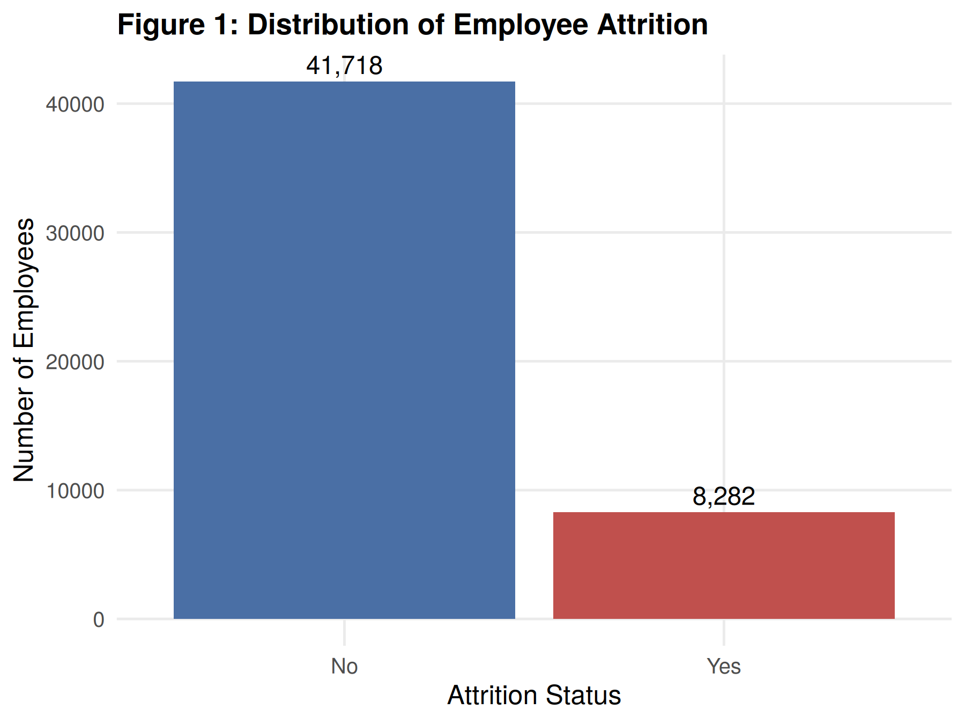
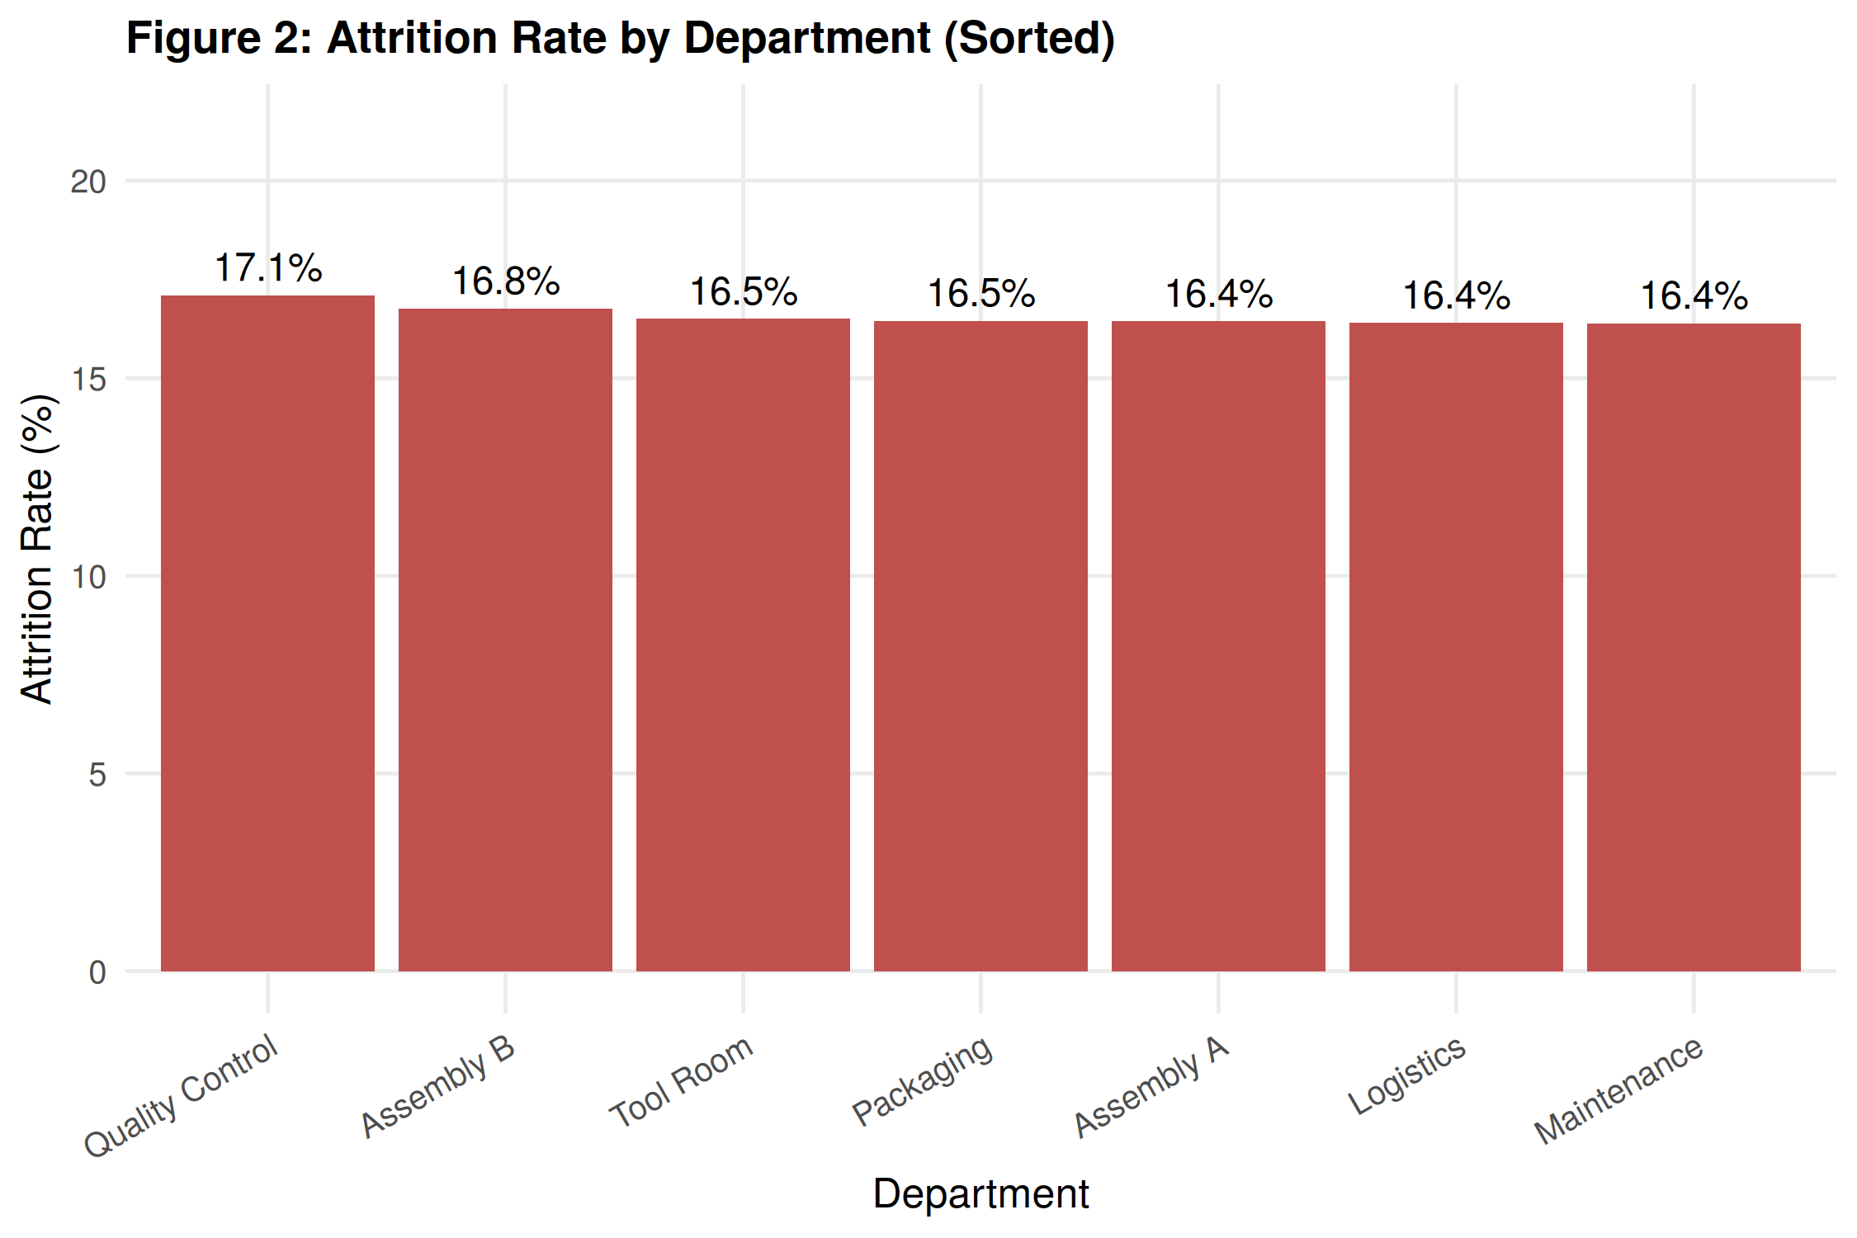
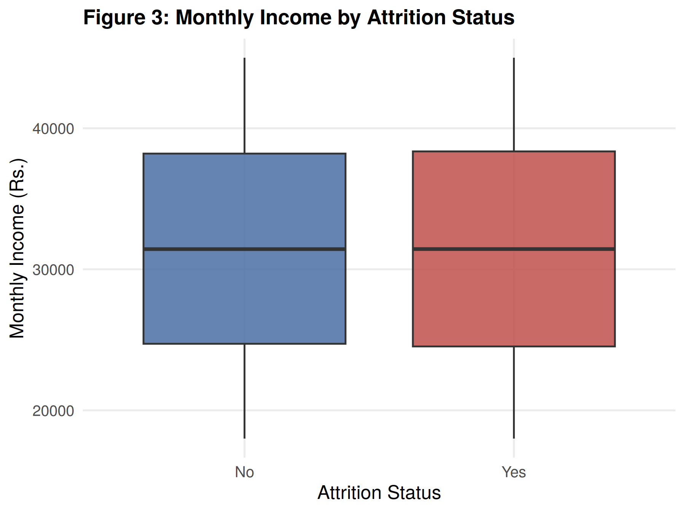
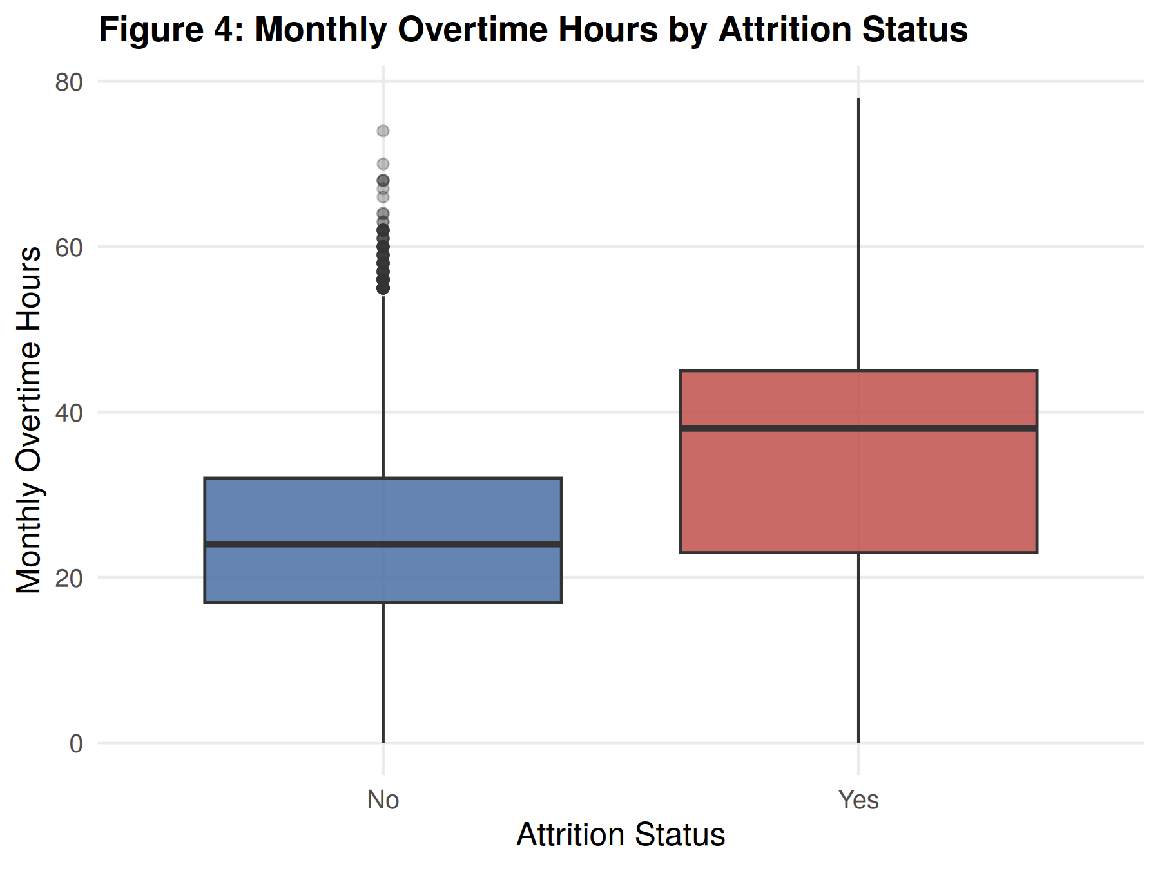
SECTION 17 · 1 OF 2
Key Visualizations
Attrition Distribution
Attrition by Department
83.44% retained vs. 16.56% left
Quality Control highest (17.1%); spread < 1 pt
Income vs. Attrition
Overtime vs. Attrition
Nearly identical — income shows no relationship
Median 38 hrs (left) vs. 24 hrs (stayed)
DA1 · EMPLOYEE ATTRITION PREDICTION
19 / 25
Notes:
Four of the eight EDA visualizations, reproduced directly from the R analysis. Figure 1 shows the target class distribution: 41,718 retained (83.44%) vs 8,282 left (16.56%). Figure 2 sorts departments by attrition rate — Quality Control has the highest rate at 17.1%, followed by Assembly B (16.8%), with the total spread across all seven departments under one percentage point, meaning department membership alone carries little discriminating power. Figure 3 shows monthly income by attrition status — the two boxplots are nearly identical, indicating income shows almost no relationship with attrition (correlation of only 0.002), which is notable since compensation is often assumed to be a primary driver. Figure 4 shows monthly overtime hours by attrition status — employees who left have a substantially higher median overtime (38 hours/month) than those who stayed (24 hours/month), with MonthlyOvertimeHours showing the strongest positive correlation with attrition (+0.321) of any numeric variable.

Slide 20
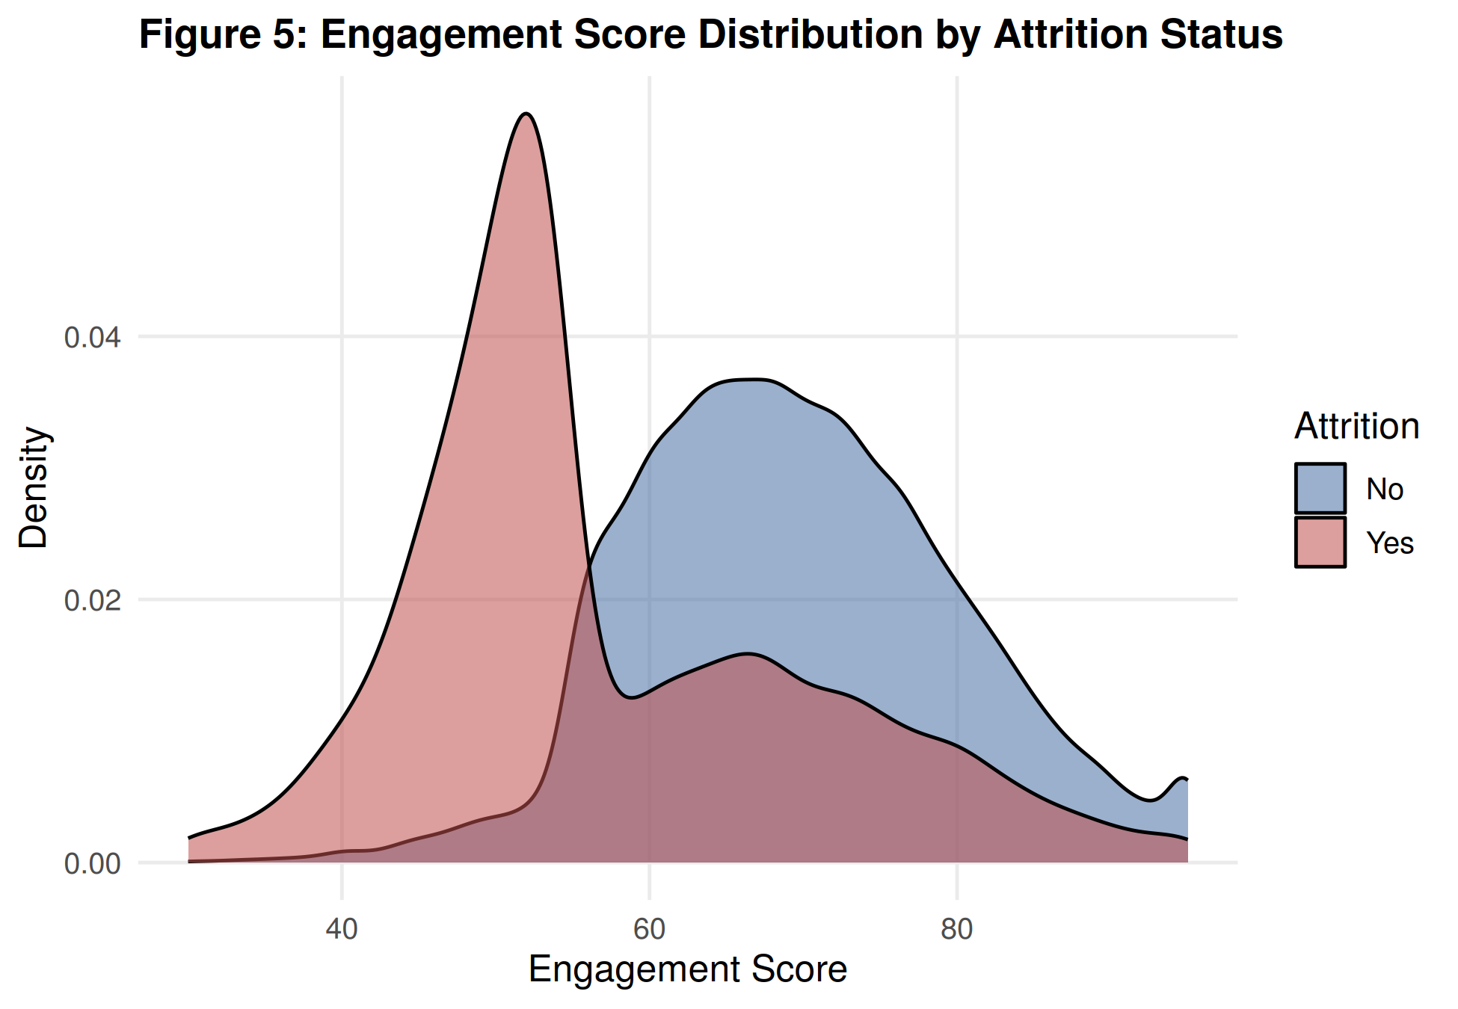
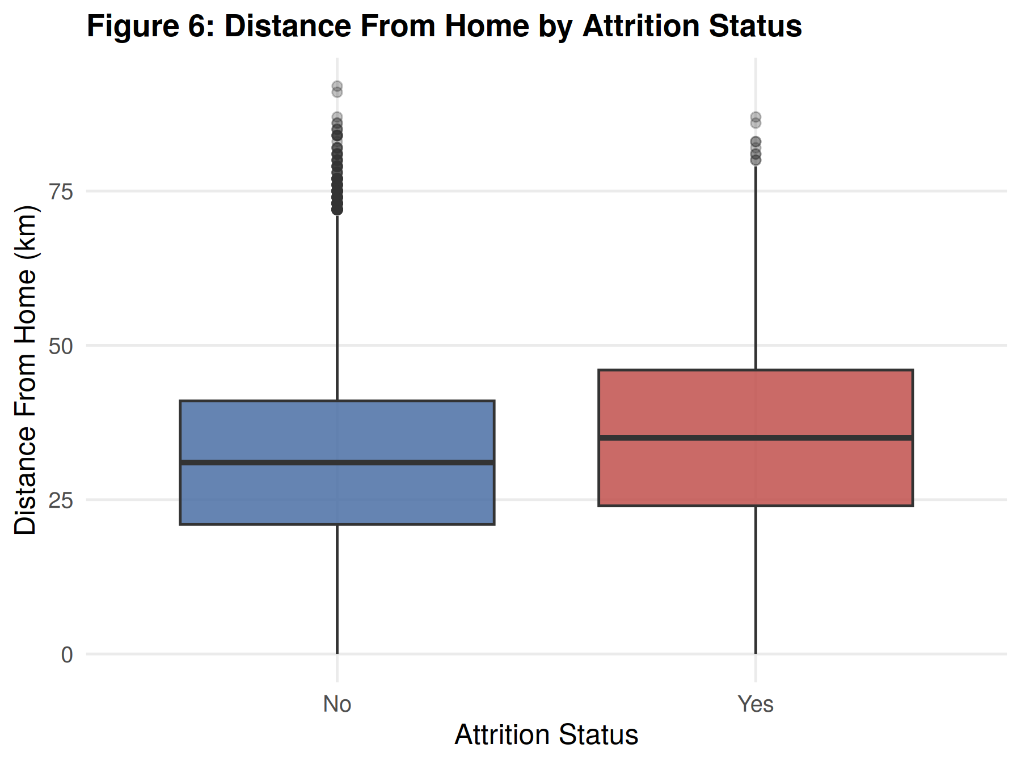
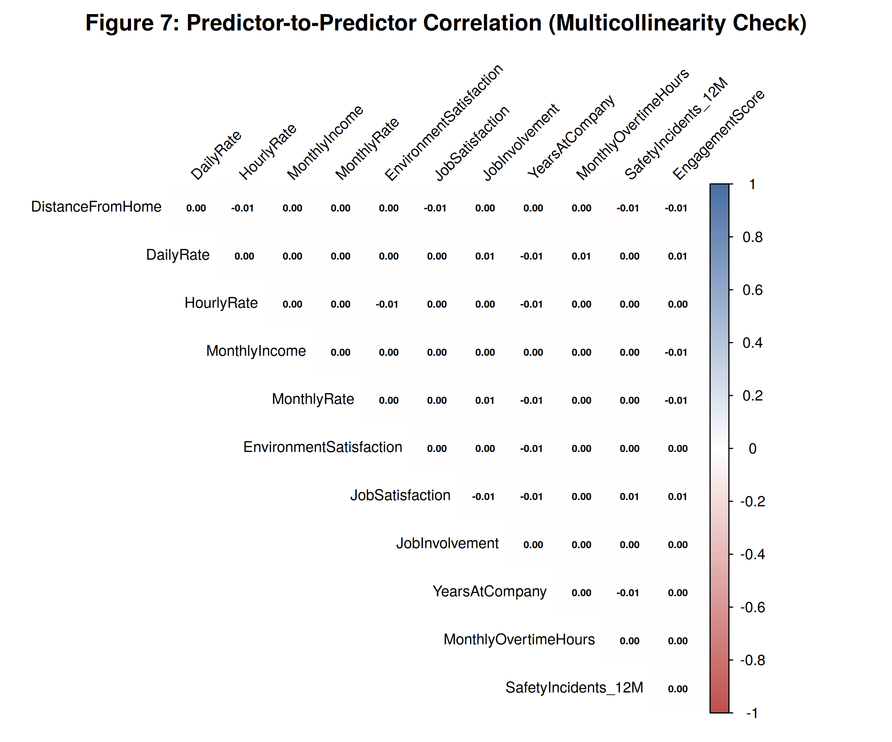
SECTION 17 · 2 OF 2
Key Visualizations
Engagement vs. Attrition
Distance vs. Attrition
Predictor Correlation
Sharp separation — the clearest signal
Modest shift: 35 km (left) vs. 31 km (stayed)
Near-zero everywhere — confirms no multicollinearity
DA1 · EMPLOYEE ATTRITION PREDICTION
20 / 25
Notes:
The remaining four EDA visualizations. Figure 5 shows engagement score distribution by attrition status — the most visually distinct pattern in the entire analysis: employees who left are heavily concentrated around an engagement score of roughly 50, while retained employees show a broader distribution peaking near 65–70, with the two densities barely overlapping. EngagementScore has the strongest correlation with attrition overall (−0.395). Figure 6 shows distance from home by attrition status — a modest but visible upward shift for employees who left (median ~35 km vs ~31 km for those retained), consistent with its smaller correlation (0.088). Figure 7 is the predictor-to-predictor correlation heatmap, deliberately excluding the diagonal and focusing only on relationships among the numeric predictors themselves — every off-diagonal value rounds to between −0.01 and 0.01, confirming the numeric predictors carry independent, non-redundant information with no meaningful multicollinearity. This is included specifically to validate that finding, not to reveal a strong pattern.

Slide 21
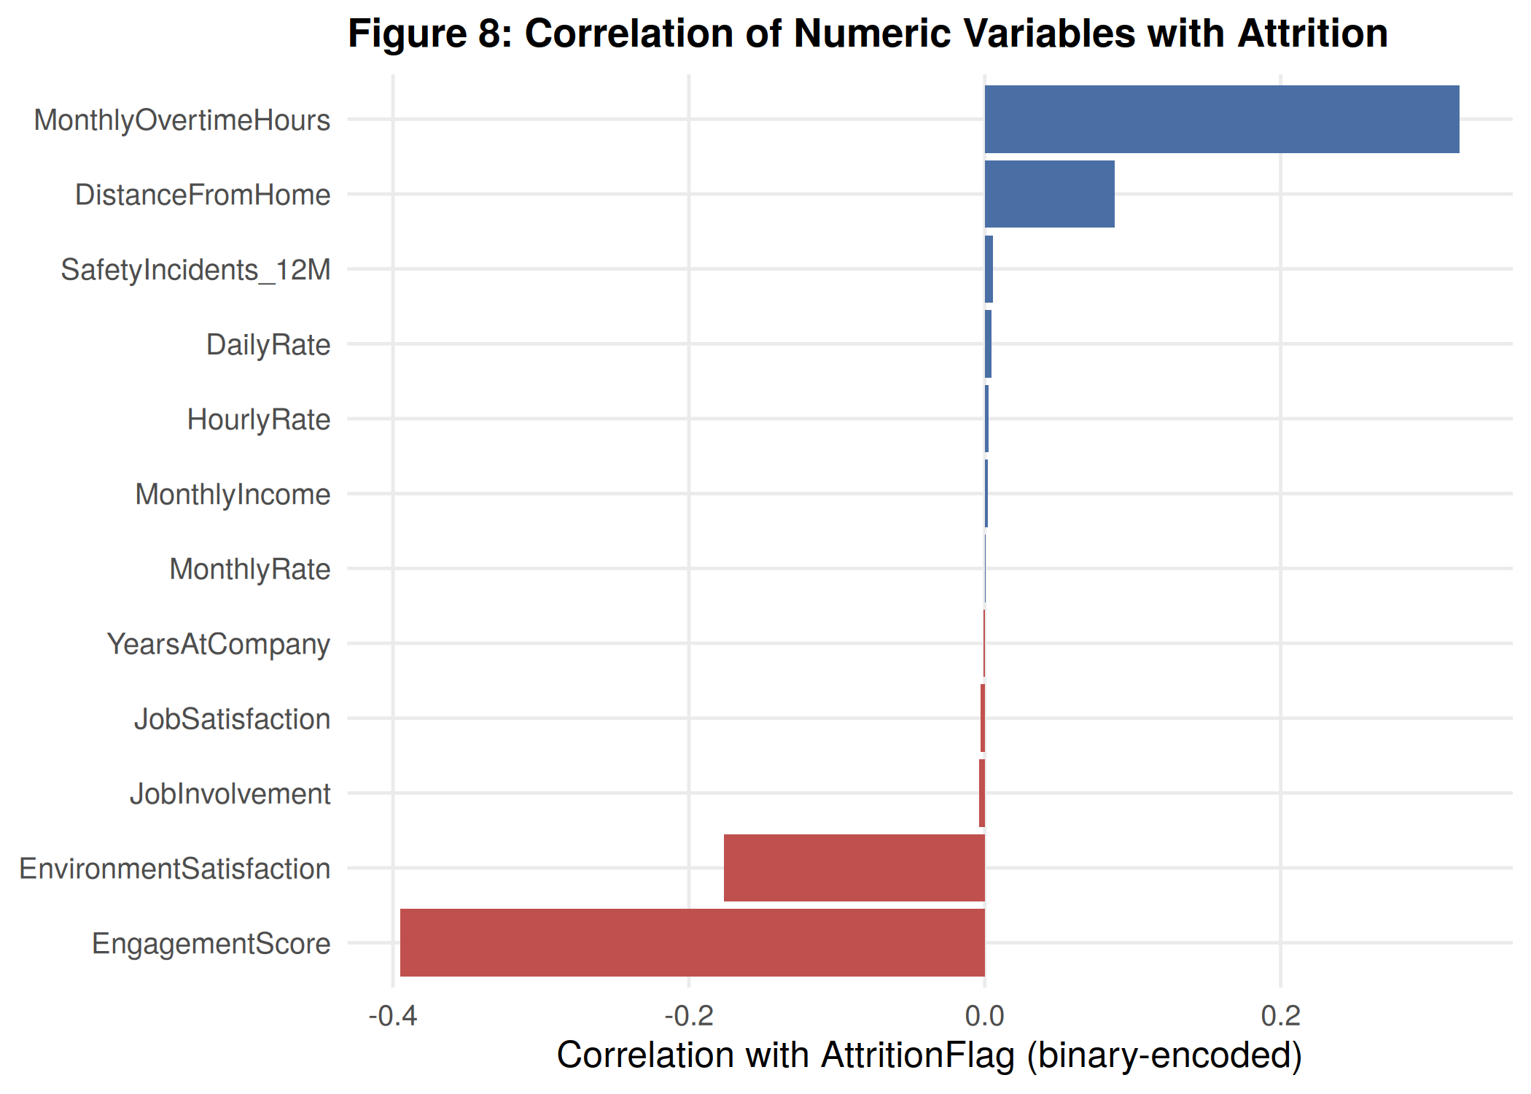
SECTION 18
Major Findings
EngagementScore
−0.395
MonthlyOvertimeHours
+0.321
EnvironmentSatisfaction
−0.176
DistanceFromHome
+0.088
Compensation & Tenure
≈ 0.00
Compensation and tenure show no meaningful relationship — challenging common assumptions about why employees leave.
DA1 · EMPLOYEE ATTRITION PREDICTION
21 / 25
Notes:
This chart quantifies and consolidates the patterns observed across the EDA. EngagementScore shows the strongest relationship with attrition overall at −0.395, followed by MonthlyOvertimeHours at +0.321, and EnvironmentSatisfaction at −0.176, with DistanceFromHome a distant fourth at +0.088. All compensation-related variables (DailyRate, HourlyRate, MonthlyIncome, MonthlyRate) and organizational tenure (YearsAtCompany) cluster near zero correlation, confirming that pay and length of service are not meaningfully associated with attrition in this dataset — a finding that runs counter to common assumptions about why employees leave. Department-wise attrition rates were also found to be fairly uniform (16.4%–17.1%), with Quality Control only marginally elevated. The near-zero correlations among the numeric predictors themselves (seen in the separate correlation heatmap) confirm these variables provide largely independent, non-redundant information.

Slide 22
SECTION 19
Conclusion
A 50,000-record, 21-feature anonymized multi-plant HR dataset was identified and justified.
Verified complete: zero missing values, zero duplicate records.
Redundancy removed, outliers flagged, encoding and scaling applied — all in R.
EngagementScore and MonthlyOvertimeHours emerged as the strongest attrition signals.
Compensation and tenure showed little relationship — challenging common assumptions.
All six objectives were met; the foundation for predictive modelling is in place.
DA1 · EMPLOYEE ATTRITION PREDICTION
22 / 25
Notes:
This report has documented the first phase of the project on employee attrition prediction, covering problem formulation, dataset identification, literature review, dataset understanding, preprocessing, and exploratory data analysis. An anonymized, multi-plant HR dataset comprising 50,000 employee records and 21 attributes was identified and justified as a suitable basis for studying attrition, offering greater scale and organizational diversity than the small, single-site benchmark datasets used in the majority of prior published studies. The dataset was found to be complete and well-structured, with no missing values and no duplicate records. Preprocessing verified and addressed a redundancy between Education and EducationLevel, removed the non-predictive EmployeeNumber identifier, applied IQR-based outlier detection, encoded categorical variables, and standardized numerical variables with differing scales. The EDA revealed that attrition is most strongly associated with EngagementScore and MonthlyOvertimeHours, with EnvironmentSatisfaction and DistanceFromHome contributing secondary associations, while compensation-related variables and tenure showed almost no relationship with attrition. These findings directly address the six objectives set out earlier and confirm the research gap identified in the literature review — that comprehensive preprocessing and exploratory analysis on a large-scale industrial HR dataset can surface engagement- and workload-related drivers of attrition that are underrepresented in existing literature. Limitations: this phase is exploratory and associative, not causal, and no predictive model has yet been built or validated.

Slide 23

SECTION 20
Future Scope
The cleaned, encoded, and scaled dataset — along with the patterns identified here — provides a well-grounded foundation for the predictive modelling phase to follow.
Model Development
Priority Features
Working System
Develop, train, and evaluate classification techniques (DA2 phase).
EngagementScore and MonthlyOvertimeHours as leading predictive features.
Translate exploratory findings into a working attrition prediction system.
DA1 · EMPLOYEE ATTRITION PREDICTION
23 / 25
Notes:
The cleaned and prepared dataset, along with the patterns identified in this report — particularly the strong associations involving EngagementScore and MonthlyOvertimeHours — provide a well-grounded foundation for the predictive modelling phase to follow, in which classification techniques can be developed, trained, and evaluated to translate these exploratory findings into a working attrition prediction system. This next phase (DA2) will build on the cleaned, encoded, and scaled dataset established here.

Slide 24
SECTION 21 · APA 7TH EDITION
References
1
Al Akasheh, M., Hujran, O., Malik, E. F., & Zaki, N. (2024). Enhancing the prediction of employee turnover with knowledge graphs and explainable AI. IEEE Access, 12, 77041–77053.
2
Guerranti, F., & Dimitri, G. M. (2023). A comparison of machine learning approaches for predicting employee attrition. Applied Sciences, 13(1), 267.
3
Li, W. (2023). A transformer-based deep learning framework to predict employee attrition. PeerJ Computer Science, 9, e1570.
4
Nawaz, M. S., Nawaz, M. Z., Fournier-Viger, P., & Luna, J. M. (2024). Analysis and classification of employee attrition and absenteeism in industry: A sequential pattern mining-based methodology. Computers in Industry, 159, 104106.
5
Raza, A., Munir, K., Almutairi, M., Younas, F., & Fareed, M. M. S. (2022). Predicting employee attrition using machine learning approaches. Applied Sciences, 12(13), 6424.
DA1 · EMPLOYEE ATTRITION PREDICTION
24 / 25
Notes:
Five peer-reviewed references were used in the literature review, all published between 2022 and 2024 in reputable venues: IEEE Access, Applied Sciences (MDPI), PeerJ Computer Science, and Computers in Industry (Elsevier). Full APA 7th edition citations are shown on this slide, matching the references list in Section 7.4 of the written DA1 report.

Slide 25

Thank You
Questions & Discussion Welcome
Vansh Goyal (24BDS1156) · Ritabrata Dey (24BDS1129) · Chetan Pareek (24BDS1125)
Programming for Data Science · SCOPE · VIT Chennai
Notes:
Thank you for your attention. We welcome any questions about the dataset, preprocessing methodology, or exploratory findings presented today. This concludes the DA1 presentation on Employee Attrition Prediction Using Machine Learning.

